Slide 2


Slide 3
USA Today:
The report also said that doctors concluded Piazza suffered from "multiple traumatic brain injuries," including a fractured skull and a lacerated spleen, which resulted in 80 percent of his blood supply in his abdominal cavity.

Slide 5
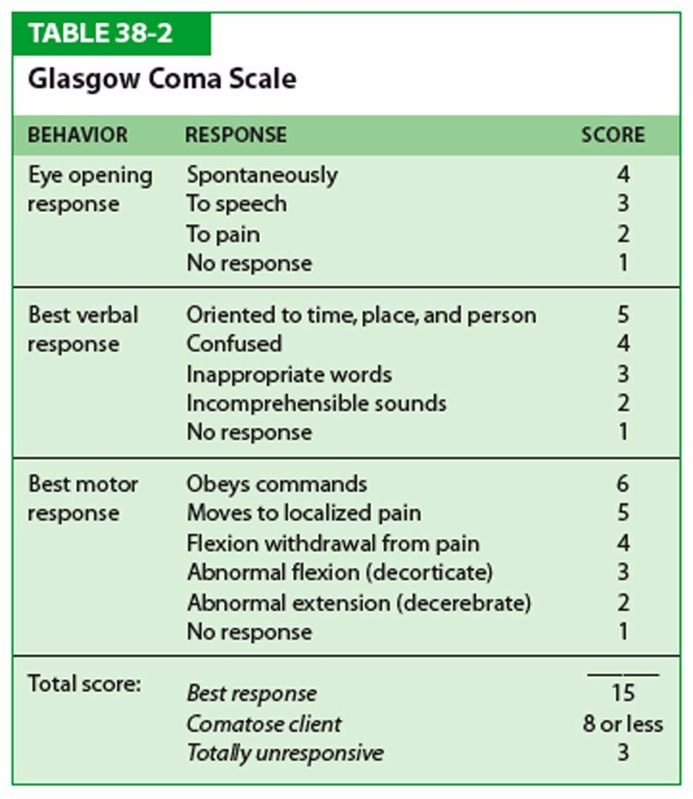
Source: https://s-media-cache-ak0.pinimg.com/originals/26/63/ba/2663ba1437970ffab8fc75d889817a22.jpg

Slide 6
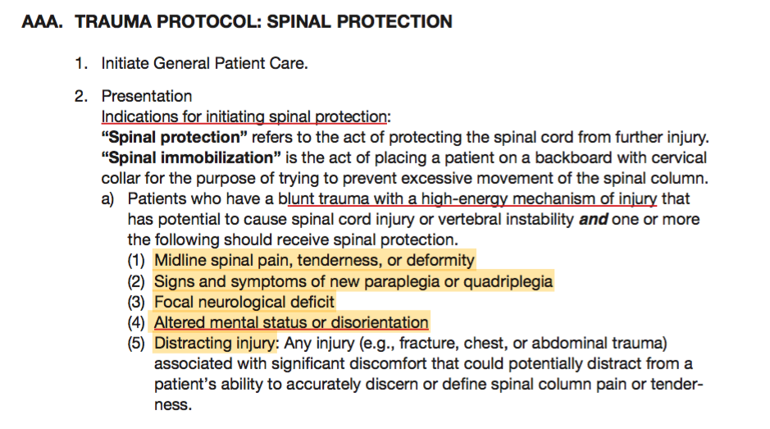
Source: 2016 MIEMSS Protocols

Slide 7
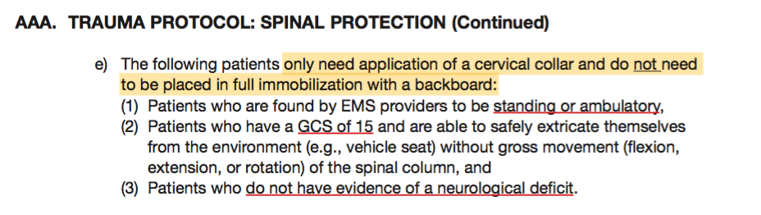
Source: 2016 MIEMSS Protocols

Slide 9
Traumatic Brain Injuries
Primary Brain Injury: immediate damage to the tissue from the direct injury
Secondary Brain Injury: hypoxia from increased perfusion from the primary injury
The brain swells, vessels vasodilate and blood accumulates and causes increased pressure a decrease in blood flow over several hours
Do Not Let Them Get Hypoxic!!
This is our moment to literally save their life

Slide 10
Intracranial Pressure (ICP): the pressure of the brain and contents within the skill
> 15 mmHg is dangerous
> 25 mmHg will cause cerebral herniation
Cerebral Perfusion Pressure (CPP): the pressure of the blood flowing through the brain

Slide 11

Cushing’s Reflex
The body’s protective response to maintain constant perfusion pressure
↑ICP → ↑BP to force blood to the brain
Then the body slows down the HR to try and control the BP
This cycle continues until ICP ≅ Mean Arterial Pressure and then there is no cerebral perfusion and the brain dies

Slide 12
How Do We Fix It
Maintain a higher than standard blood pressure
Ideally SBP 110-120 mmHg
Control the Airway! Intubation!?
Control respiratory rate
Prevent hypoxia! Secondary Brain Injury
Prevent rapid loss of a patent airway
Hyperventilation as a last ditch effort
Signs/Symptoms clearly indicated a TBI
Corrected hypoxia and hypotension
This will only briefly fix cerebral swelling temporarily

Slide 13
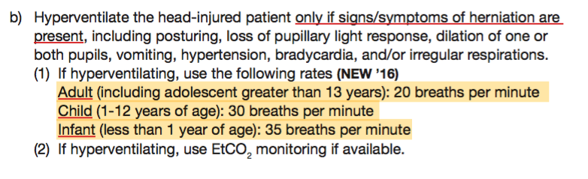
Hyperventilation
From ITLS 7th Edition:
TBI with GCS < 9 with extensor posturing (decerebrate)
TBI with GCS < 9 with asymmetric (or bilateral), dilated, or nonreactive pupils
TBI with initial GCS < 9 and a subsequent drop > 2 points
Source: 2016 MIEMSS Protocols

Slide 14
But Why?
Normal blood CO₂ is 35-45 mmHg measured by waveform capnography
Increased CO₂ (hypoventilation) causes vasodilation as the body tries to self-correct
Lowering the CO₂ by hyperventilation to 30-35 mmHg causes vasoconstriction and decreases blood flow
Only a slight impact on brain swelling but a significant decrease in cerebral perfusion from vasoconstriction

